Slide 1
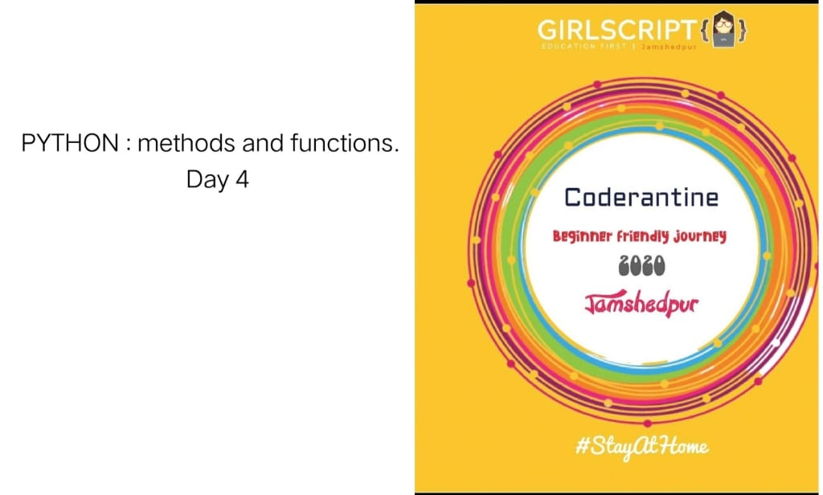
Presented By : Pooja Mishra

Slide 2
Content
What is Function?
How function works?
How to define function?
How to call Function ?
Function Type
Built in function
User-Define-function
String function
Return Keyword

Slide 3
What is Function
In Python, a function is a group of related statements that performs a specific task.
Functions help break our program into smaller and modular chunks. As our program grows larger and larger, functions make it more organized and manageable.
Furthermore, it avoids repetition and makes the code reusable.

Slide 4
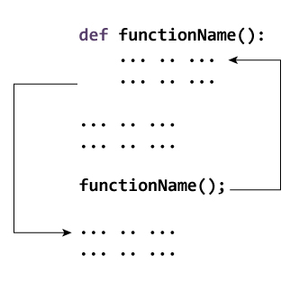
How function works?

Slide 5
How to define function
Syntax Of python
def function_name(parameters):
"""docstring"""
statement(s)
Keyword def that marks the start of the function header.
A function name to uniquely identify the function
Parameters (arguments) through which we pass values to a function. They are optional.
A colon (:) to mark the end of the function header.
One or more valid python statements that make up the function body. Statements must have the same indentation level (usually 4 spaces).
An optional return statement to return a value from the function.

Slide 6
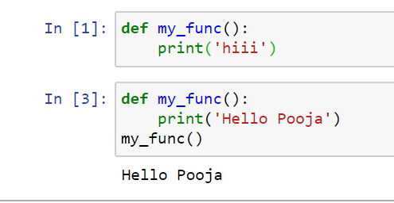
Example of Function

Slide 7
How to call Function
Once we have defined a function, we can call it from another function, program or even the Python prompt.
To call a function we simply type the function name with appropriate parameters.

Slide 8
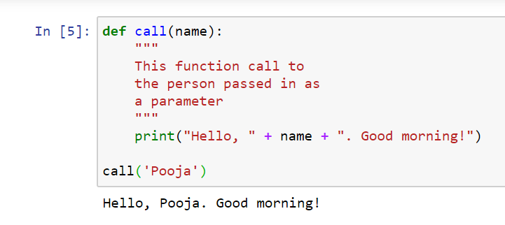
How to call function ?

Slide 9
Function Type
There are two types of Function
Built-in functions - Functions that are built into Python.
User-defined functions - Functions defined by the users themselves

Slide 10
Built in functions
Python abs()
returns absolute value of a number
Python any() function
Checks if any Element of an Iterable is True
Python all()
returns true when all elements in iterable is true
Python ascii()
Returns String Containing Printable Representation
Python bin()
converts integer to binary string
Python bool()
Converts a Value to Boolean
Python bytearray()
returns array of given byte size
Python callable()
Checks if the Object is Callable
Python bytes()
returns immutable bytes object

Slide 11
Python chr()
Returns a Character (a string) from an Integer
Python compile()
Returns a Python code object
Python classmethod()
returns class method for given function
Python complex()
Creates a Complex Number
Python delattr()
Deletes Attribute From the Object
Python dict()
Creates a Dictionary
Python dir()
Tries to Return Attributes of Object

Slide 12
Python divmod()
Returns a Tuple of Quotient and Remainder
Python enumerate()
Returns an Enumerate Object
Python staticmethod()
transforms a method into a static method
Python filter()
constructs iterator from elements which are true
Python eval()
Runs Python Code Within Program
Python float()
returns floating point number from number, string
Python format()
returns formatted representation of a value

Slide 13
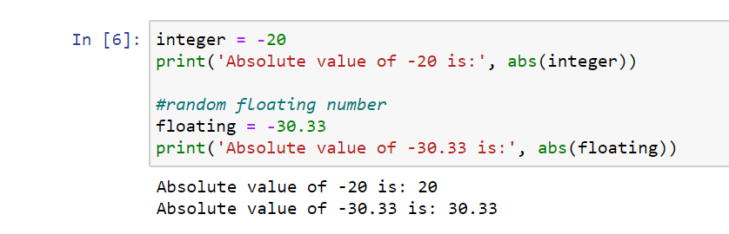
xa.

Slide 14
What are user-defined functions in Python?
Functions that we define ourselves to do certain specific task are referred as user-defined functions. The way in which we define and call functions in Python are already discussed.
Functions that readily come with Python are called built-in functions. If we use functions written by others in the form of library, it can be termed as library functions.
All the other functions that we write on our own fall under user-defined functions. So, our user-defined function could be a library function to someone el

Slide 15
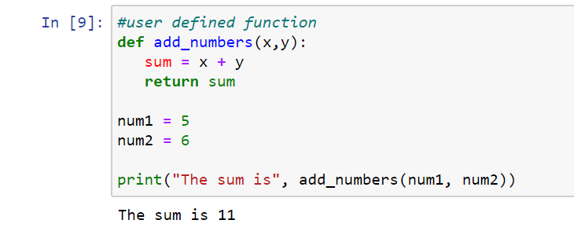
Ex.

Slide 16
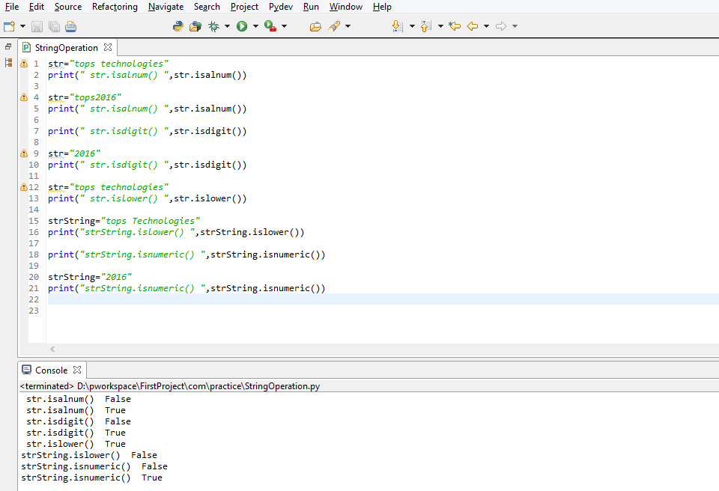
String Function

Slide 17
Return Keyword
The return statement is used to exit a function and go back to the place from where it was called.
Syntax : return [expression_list]
This statement can contain an expression that gets evaluated and the value is returned.
If there is no expression in the statement or the return statement itself is not present inside a function, then the function will return the None object.

Slide 18
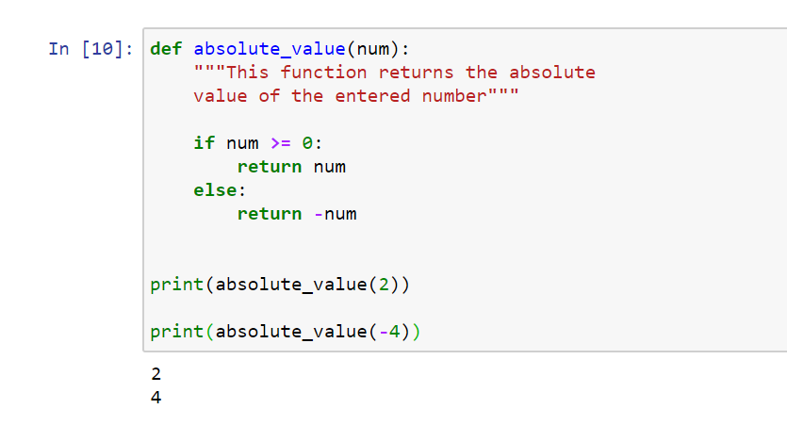
Example

Slide 19
Thank You

